Slide 1

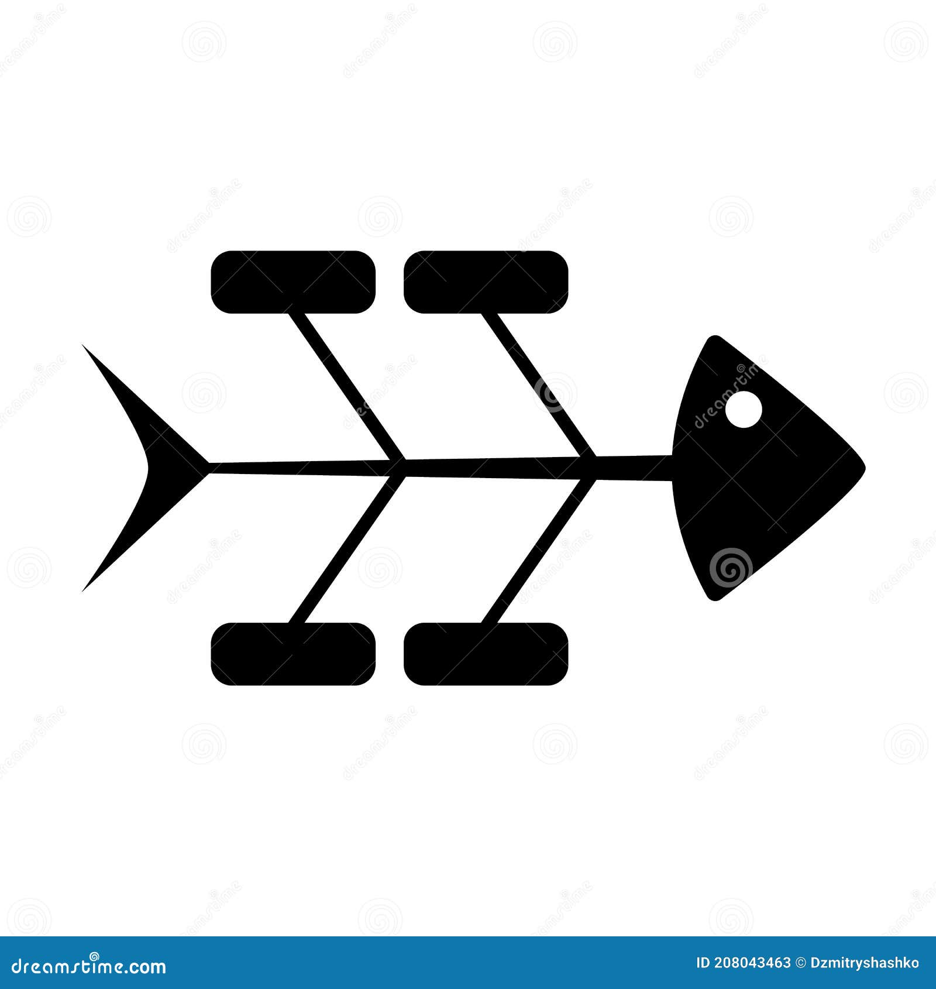
Specialization: Process Mapping & Gap Analysis
Business Focus: Brewery Industry
Tool: Draw.io, fishbone
Capstone Project- Gap Analysis and Process Mapping
Project Learning Opportunities
This case study is aimed at testingthe student’s understanding on gap analysis and process mapping
Tools and Technology to be Used

Slide 2


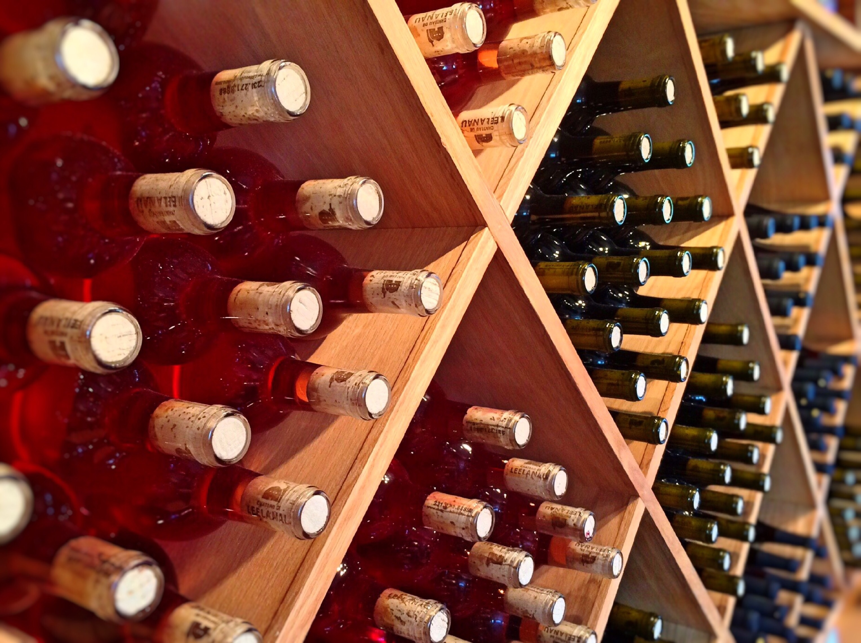

Case Study Overview
Introduction to the Business
Barrel & Brew is a popular, family-owned craft winery that has been operating for a decade. Known for its unique, small-batch Wine, the company has built a loyal following in its local region. Over the past year, Barrel & Brew has seen a surge in demand, with its products now stocked in over 500 local restaurants. While this growth is a positive sign, the company is struggling to keep up.
PNG ILLUSTRATION OF THE TYPE OF BUSINESS

Slide 3

Case Study Overview
Challenges Encountered
The increase in demand has exposed significant weaknesses in the company's operations. The following issues are now a regular occurrence:
Production Delays: The brewery consistently fails to meet its weekly production targets. This has led to inventory shortages, with popular beers frequently out of stock for days at a time.
Quality Inconsistency: Batches of the same beer have started to taste slightly different. On two separate occasions, an entire batch had to be discarded due to a sour taste, resulting in a significant financial loss.
PNG ILLUSTRATION OF THE BUSINESS CHALLENGE

Slide 4
Case Study Overview
Challenges Encountered
Employee Morale: Brewery staff, from the brewers to the bottling team, are stressed and overworked. Overtime hours have increased by 30%, and a key brewer recently resigned, citing "unmanageable pressure.
Inefficient Processes: Brewers track their recipes, ingredient inventory, and fermentation progress using a combination of handwritten notebooks and a shared, out-of-date spreadsheet. This leads to errors and time spent searching for information.
Inaccurate Forecasting: The sales manager relies on intuition and informal conversations with restaurant owners to predict demand. There is no formal system to track weekly sales data from distributors, which results in inaccurate production planning and frequent inventory overstock or shortages.
PNG ILLUSTRATION OF THE BUSINESS CHALLENGE

Slide 5
Case Study Overview
Challenges Encountered
Outdated Equipment: The main bottling line frequently jams, requiring manual intervention that can halt production for an hour or more. The brewing tanks are nearing the end of their lifespan and require constant small repairs.
Communication Gaps: The sales team often promises a new batch of beer to a customer without consulting the production team to confirm its availability, creating conflict and disappointed customers.
PNG ILLUSTRATION OF THE BUSINESS CHALLENGE

Slide 6
Case Study Overview
Proposed Solution
The leadership team at Barrel & Brew has a clear vision for the future, which they believe will allow them to scale their business sustainably. Some of the keys parameters include;
Reliable Production
High Quality
Empowered Staff
Streamlined Operations
Data-Driven Decisions
Modern Infrastructure
PNG ILLUSTRATION OF THE BUSINESS CHALLENGE

Slide 7
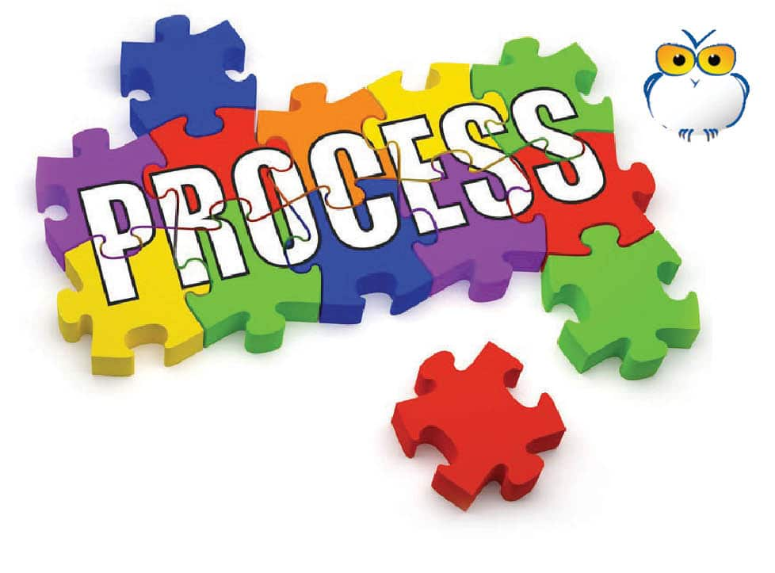
Case Study Overview
Current and Future Process flow
PNG ILLUSTRATION OF THE BUSINESS CHALLENGE
At the brewery, please click the object below to access the current and proposed process steps;

Slide 8





Rationale for the Project
(What is the Importance of the project to the business)
1.
2.
3.
Increased efficiency
Streamline administrative tasks by eliminating manual data transfer between disconnected systems.
Improved Student’s experience
Provide a unified platform for seamless access to all university services and information.
Enable Data-driven decisions
Offer comprehensive, integrated data for better reporting and strategic insights.

Slide 9
Using the Case Study;
Gap Identification: Based on the information provided, identify the specific gaps between the current state and the desired state.
Issue Categorization: Categorize the issues you've identified into the various source category using the fishbone diagram.
Create a process map (flowchart) that visually represents the current process for brewing, from recipe planning to bottling. What actions should be taken to bridge the gap between the current and their desired state (proposed Solution) . Map out the proposed solution using swim lane diagram.
Case Study Task

